Slide 1
Employee Data Analysis using Excel
STUDENT NAME:R.GAYATHRI
REGISTER NO: UNM143922CZA48
DEPARTMENT: COMMERCE B.COM (GENERAL)
COLLEGE : SHREE CHANDRAPRABHU JAIN COLLEGE MINJUR

Slide 2
PROJECT TITLE
Employee Performance Analysis using Excel

Slide 3


AGENDA
Problem Statement
Project Overview
End Users
Our Solution and Proposition
Dataset Description
Modelling Approach
Results and Discussion
Conclusion
3/21/2024 Annual Review

Slide 4

PROBLEM STATEMENT
1. Inconisistent employee performance data
2. Identifying pattrens
3. Employee metrics
4. decision making
5. actionable insights

Slide 5

PROJECT OVERVIEW
CONTENT
.
•AIM; To streamline employee data analysis using excel tools
•OBJECTIVES; Identify key metrics, analyae trends & provide data -driven insights.

Slide 6

WHO ARE THE END USERS?
▪HR mangers
▪team leads & departments heds
▪company exectives
company manager

Slide 7

OUR SOLUTION AND ITS VALUE PROPOSITION
CONTENT:
Implement excel-based
data analysis techniques.
Generate automated reports
and dashboards.
Enable easy data
manipulation and visualization

Slide 8
Dataset Description
CONTENT:
Data collected from employee records,including
performance,attendance,& demographics
Number of records,time span,& key variables

Slide 9

THE "WOW" IN OUR SOLUTION
CONTENT:
automated reporting : our excel based
system automates complex reporting tasks, saving
HR managers hours of manual work. Tise enables
quick access to insightful data withoout the need for
extensive excel expertise
3/21/2024 Annual Review
9

Slide 10
MODELLING
CONTENT: Data cleaning and preprocessing
Using excel functions for statistical
analysis
Visualization using excel charts and pivot
10

Slide 11
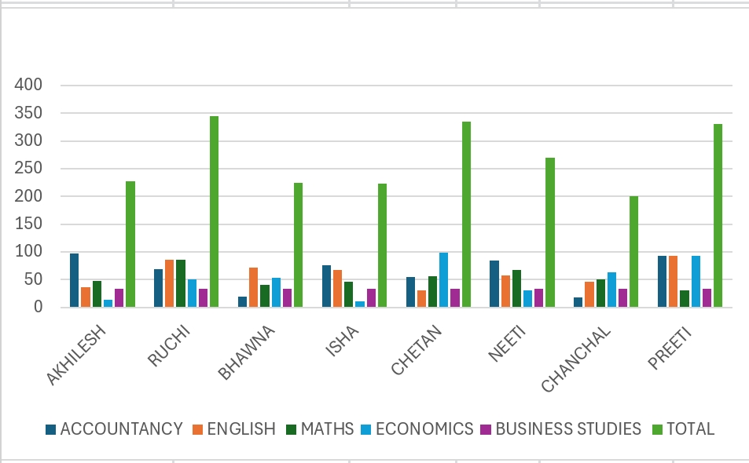
RESULTS
11

Slide 12
conclusion
CONTENT:
Summary of insights gained
impact on decision-making and
empolyee management
Future steps for futher analysis or
implementation

